Slide 1
Holy Week & The Way of the Cross

Slide 2
Palm Sunday
Notes:
Palm Sunday is the beginning of Holy Week. On this day Jesus arrives into Jerusalem on a donkey to celebrate the Passover. The people welcome Jesus, waving palms and shouting Hosanna! They have heard all about the miracles he has performed, about the disciples who have left everything to follow him and about his teachings in the temple. They truly believe that Jesus is the Messiah, the one sent by God to save them. “This man has turned water into wine”
“He has helped the blind see and the lame walk
He has walked on water and raised people from the dead
He truly is the Son of God”

Slide 3
Holy Thursday – Jesus washes the feet
Notes:
On Holy Thursday we remember Jesus washing the feet of his disciples. Peter asks him
Peter: “Lord are you going to wash my feet?”
and Jesus replies
Jesus: “Unless I wash your feet you cannot be part of me and you will not be cleansed from sin. I have washed your feet to show you how you must carry on my work”

Slide 4
Holy Thursday – shares the Last Supper
Notes:
Then Jesus shares the Last Supper with his disciples. He knew that the time was near for him to die. It is at this meal that Jesus broke the bread, blessed the wine and shared it, asking us to
Jesus “Do this is memory of me”

Slide 5
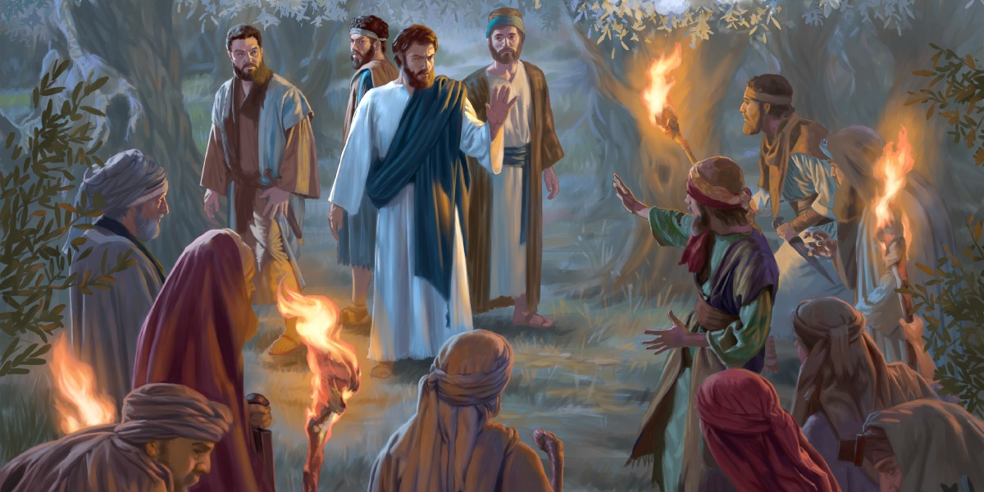
Jesus Is betrayed by Judas and arrested in the Garden of gethsemane
Notes:
After the supper we remember Jesus going to the Garden of Gethsemane to pray. Jesus is worried and afraid about the suffering that he knows he has to endure and he asks God his Father in heaven to give him courage. He asks his disciples to stay awake while he prays but each time he returns the disciples have fallen asleep. Jesus is disappointed in his friends.
Jesus “Could you men not keep watch with me for one hour?” Watch and pray so that you will not fall into temptation. The spirit is willing, but the body is weak.”
When he returns the third time his friends are still sleeping.
“Are you still sleeping and resting? Look, the hour is near, and the Son of Man is betrayed into the hands of sinners. Rise, let us go! Here comes my betrayer!
We remember how Judas agreed to betray his friend Jesus for 50 pieces of silver.
Judas: “The man I kiss is the man you want. Arrest him”
Judas arrives with the chief priests and the Pharisees. Jesus says to Judas
“Be quick about it friend” and Judas kisses him on the cheek.
Peter draws his sword and cuts of one of the soldiers ears. Jesus tells him:
‘Put your sword away for those who live by the sword must die by the sword”

Slide 6
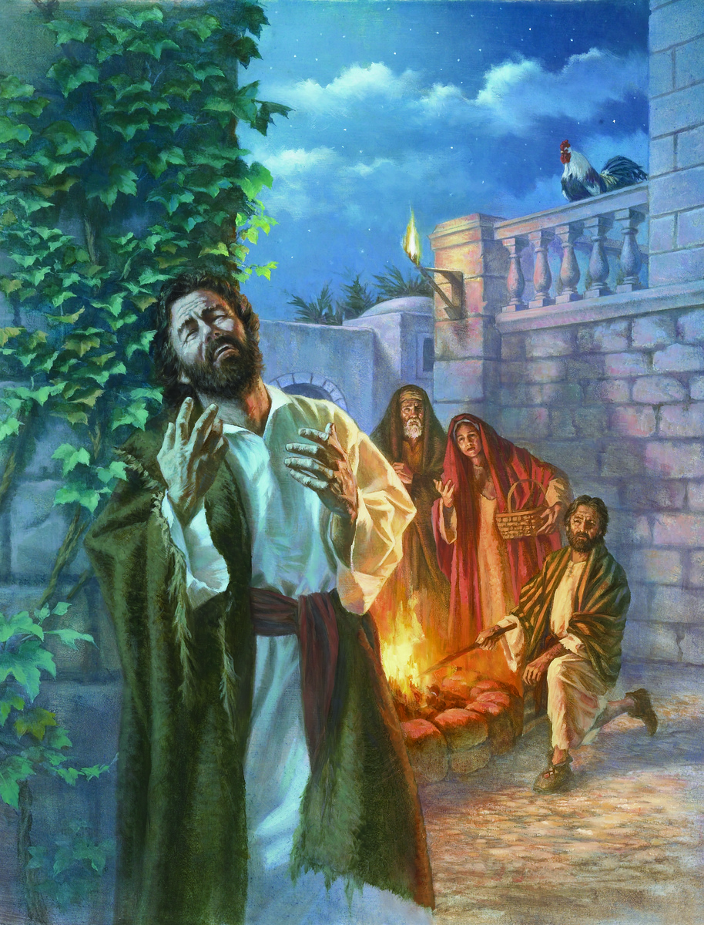
Peter denies that Jesus is His friend
Notes:
Jesus is then taken away and Peter, follows at a distance. Some people recognise him as Jesus’ friend.
Person 1:“You are one of his disciples aren’t you? “
Peter replies
“I am not”
Again Peter is asked
”Did I not see you in the garden with him?”
but Peter says
“I was not, I swear I do not know this man
At that moment the cock crowed and Peter remembered what Jesus had told him at the last supper, :Before the cock crows you will have disowned me three times”
Ashamed Peter runs away and weeps.

Slide 7
Jesus before Pilate
Notes:
Jesus is then brought before Pilate who asks him,
“Are you the King of the Jews?”
Jesus replies
“ My Kingdom is not of this world, if it was my father would send an army to save me being handed over to the Jews.”
Again pilate asks him
Pilate “So you are a king?
To which Jesus replies
“ You say I am a King , I was brought into the world for this, to testify to the truth.
Piate replies “What is truth!”
But pilate can find no case against Jesus. His wife has also had a dream in which she has been told to tell her husband to have nothing to do with this man. Pilate then goes to th people.
“ I wash my hands of this man, I find no case against him but since it is your custom I can release one prisoner, do you want me to release Jesus the kind of the Jews but the crowd shout “NOT THIS MAN BUT BARABBAS” and Jesus is handed over to be crucified.

Slide 8
The Stations of the Cross

Slide 9
Jesus is condemned to die
Notes:
Look at Your Heart
Has anyone ever said mean or hurtful things about you, or has anyone ever told a lie about you? If someone did that to you, look at your heart and see how you felt. Maybe you were scared, or hurt, or maybe you felt very angry.
When you see how you felt, show your heart to Jesus. See Jesus loving you when you show him what happens in your heart. Then, when you are ready, you can ask Jesus to help him make your heart more like his. Maybe you want to ask Jesus to help you to remember that God is always with you.

Slide 10
Jesus takes up His Cross
Notes:
Look at Your Heart
Have you ever had something happen that was very hard for you? Sometimes children are very sick, or someone in their family is very sick. Sometimes adults or older children do not treat younger children nicely. Sometimes we just can't have things the way we want them.
Take some time to look at what your heart is like when this happens. Then, when you see what your heart is like, show your heart to Jesus. See Jesus loving you when you show him what happens in your heart. When you are ready, you can ask Jesus to help make your heart more like his.

Slide 11
Jesus Falls for the First Time
Notes:
Look at Your Heart
Did you ever fall when you were playing, or when you were helping with something? Falling really hurts, doesn't it? When people make mistakes, it is like falling. And when that happens, their heart sometimes feels like it is hurt.
Can you remember a time when you fell, when your heart felt hurt? As you remember that time, and look at how your heart felt, show your heart to Jesus. See Jesus loving you as you show him your heart. When you are ready, you can ask Jesus to help make your heart more like his.

Slide 12
Jesus Meets His Mother
Notes:
Look at Your Heart
Have you ever been very sad, or do you know someone who has been very sad? Being sad can really hurt someone's heart a lot, can’ it? Sometimes our hearts are sad because we cannot be with someone we love.
If you can remember a time when you were very sad, show Jesus what your heart looked like when you felt that way. Picture Jesus loving you when you show him your sad heart. Then, when you are ready, you can ask Jesus to help make your heart more like his.

Slide 13
Simon helps Jesus
Notes:
Look at Your Heart
Sometimes helping someone can be difficult, for so many different reasons. Maybe you haven't finished something that you like to do, when someone asks you for help. Or maybe you just don't feel like helping that person.
Can you think of a time when you were asked to help someone and did not want to help? Show Jesus what it was like when that happened, and picture Jesus loving you as you show him your heart. Maybe you can even hear Jesus whisper, “Thank you for helping.” When you are ready, you can ask Jesus to help you to have a helping heart.

Slide 14
Veronica wipes the face of Jesus
Notes:
Look at Your Heart
Have you ever helped someone? Have you ever done something that helped someone feel better? Sometimes you may have done something that you thought was very small or unimportant: bringing a glass of water or juice to someone, or even giving someone a helping hand with a chore. Maybe you just smiled at someone who looked sad!
As you think of the times you helped, show Jesus your heart. As you picture Jesus loving you, maybe you can also picture Jesus leaving a picture of his face on your heart. What a wonderful heart you have!

Slide 15
Jesus Falls a Second Time
Notes:
Look at Your Heart
Have you ever had a hard time with something? Maybe you can’t do something the way you want, or you feel as if you keep messing up on something? How does your heart feel when that happens? Maybe your heart feels the way Jesus’ heart felt when he fell this second time.
When you show Jesus how your heart felt, picture Jesus loving you. Jesus knows how your heart felt; his heart probably felt the same way.

Slide 16
Jesus Meets the Women
Notes:
Look at Your Heart
Sometimes it is easy to just think about ourselves -- about what is not going the way we want it, or about problems that we have. It is very hard, then, to think about other people. How does your heart look when you do that, when you think only about yourself?
Show your heart to Jesus, and picture Jesus loving you with your heart that way. When you are ready, can you ask Jesus to help you have a heart like his, a heart that thinks about other people and remembers other people? That’s the kind of heart Jesus has.

Slide 17
Jesus Falls a Third Time
Notes:
Look at Your Heart
When we have really tried to do our best, and have not been able to succeed, it is easy to feel like Jesus did. Sometimes other people just keep yelling about something we do, or sometimes other people make fun of the way we do something.
Can you remember a time when you felt this tired in your heart, when you seemed to be having a sad or hard time with someone or something? Look at how your heart felt, and show your heart to Jesus. When you are ready, ask God to help you when you feel this way.

Slide 18
Jesus is stripped of His clothes
Notes:
Look at Your Heart
Is it hard for you to share or to give away something that you like? Do you sometimes like to keep everything for yourself? Do you ever let something of yours be the reason for bad feelings or bad words between you and someone else?
If you remember a time when something like this happened, remember how your heart felt. Then, show your heart to Jesus. You can ask Jesus to help you to have a heart that is like his heart.

Slide 19
Jesus is nailed to the Cross
Notes:
Look at Your Heart
Can you think of a time when someone hurt you with unkind words or actions? Was it hard for you to forgive that person?
Jesus knows that forgiving is hard to do. That's why Jesus will help to change your heart when you ask him to help you to forgive someone. See how your heart looks after you ask Jesus to do this.

Slide 20
Jesus dies
Notes:
Look at Your Heart
Did you ever feel that you wanted to make something better, or that if you only tried harder, something would change that you want to change? Or maybe you felt that you did not try hard enough at something, and something bad happened.
If you can think of a time like that, then show Jesus your heart, and let him love you. When you are ready, you can ask Jesus to help your heart be more like his heart.

Slide 21
Jesus is taken from the Cross
Notes:
Look at Your Heart
Is there someone you love who has died? When you remember that person, how does your heart look?
You can show your heart to Jesus, and show Jesus what you miss about the person who died. Jesus knows what your heart looks like, and loves you when you show him your heart. He can even help your heart become more like his.

Slide 22
Jesus is laid in the tomb
Notes:
Look at Your Heart
Can you remember a time when you were very sad to say “Good-bye” to someone? Maybe you were leaving the person for only a short time, or maybe it was for a long time. Maybe you said “Good-bye” to someone you loved when that person died.
Take a few moments to think about one of those times you were sad saying “Good-bye,” and show Jesus how your heart felt then. Try to picture Jesus loving you, and being with you with your sad heart. Let Jesus love you a lot; Jesus knows how sad your heart is.

Slide 23
Jesus rises from the dead

